Slide 1

Intro To Game Development

Slide 2

$135 Billion
Net Worth Of Gaming Development Industry in 2018

Slide 3
What does Game Development Involve ?
Game Development simply means, Making games
Game Development is a very long process and involves a variety of people in the development process.

Slide 4
The Aspects Of Game Development
Game Programmer
Artist / Animators
Game Designers
Sound Designers
Game Testers
Network and Systems Engineer

Slide 5

Does Game Development Involve Gaming?

Slide 6

Does Game Development Involve Coding ?

Slide 7


Where have you seen these logos ?

Slide 8
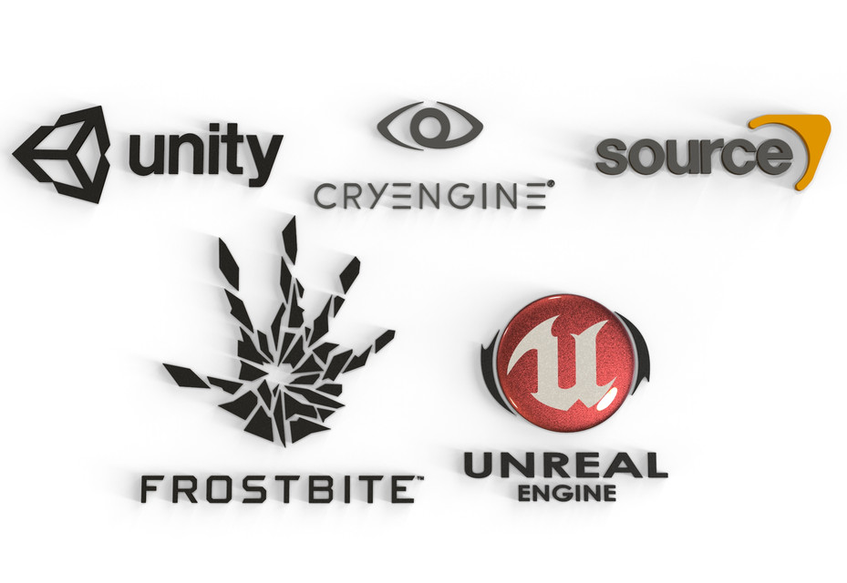
Let’s Talk About Game Engines
Game Engines provide pre-built physics environments that Game Developers and Designers can use to Build Games

Slide 9

Which Engine To Begin With ?

Slide 10

Which Language Should I Know ?

Slide 11
Why C# (C-Sharp) ?
Easy To Learn with OOP Features
.NET Framework and Large set of open source Libraries
Supported By Microsoft
Used By numerous Game Engines

Slide 12
Resources To Learn Game Development
Brackeys : https://www.youtube.com/user/Brackeys
Udemy : https://www.udemy.com/
Unity Official Tutorials : https://learn.unity.com/
Unity Documentation : https://docs.unity3d.com/Manual/index.html
Official Microsoft C# Tutorials : https://docs.microsoft.com/en-us/dotnet/csharp/tutorials/

Slide 13
Game Jams and Where To Find Them ?
Game Jams are game development competitions that run across multiple days, where people compete the best games possible from a given theme. Mostly organized Online.
Find Game Jams Here : https://itch.io/jams

Slide 14

Be an Active Part of the Game Dev Community !

Slide 15
To Join Game Dev Communities :
Join Discord: www.DiscordApp.com
Game Dev Network : https://www.GameDev.net
Game Dev League : https://www.GameDevLeague.com

Slide 16

That’s It You’re Ready To make Some Games !!

Slide 17

Let’s Look at what I have Managed To Build So Far ...

Slide 18

Thank You!

